Slide 1
Read and delete this slide…
Questions or comments on this presentation can be addressed to alastair.buxton@psnc.org.uk.
You can pick and choose the elements of the presentation that suit the needs of your event / training session.
Documents summarising NMS can be downloaded from the PSNC website, to use as speaking notes or as briefing material for hospital colleagues.
PSNC/NHS Employers guidance and resources

Slide 2
Read and delete this slide…
Reading and guidance on this subject:
RPS transfer of care guidance and resources
Keeping patients safe during transfer, Catherine Picton, PharmJ 12/6/12
MURs and the NMS at discharge, Nina Barnett, Pharmacy Magazine June 2012
Last updated: 10th November 2014

Slide 3
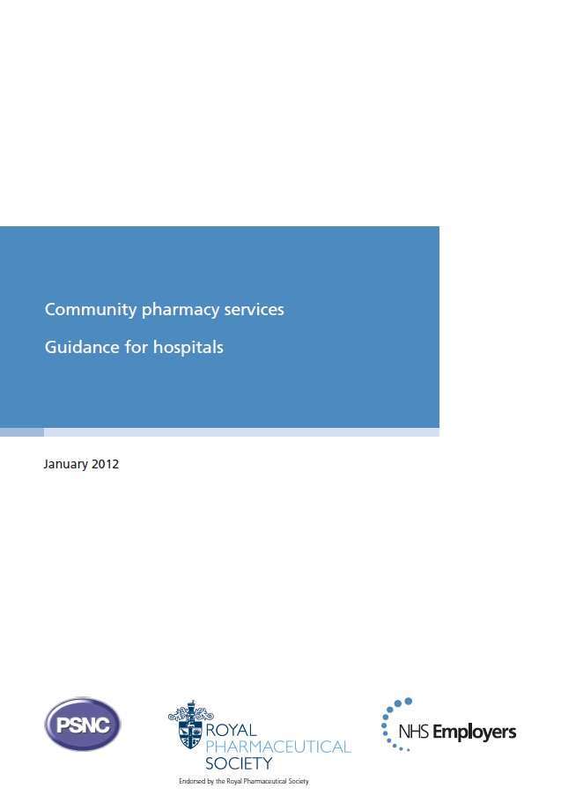
Community Pharmacy and Secondary Care:
Working together to support patients discharged from hospital

Slide 4
The challenge
Patients’ medicines are often changed in hospital:
The likelihood that an elderly medical patient will be discharged on the same medicines they had on admission to hospital is less than 10 per cent.¹
Between 28 and 40 per cent of medicines are discontinued during a hospital stay² and 45 per cent prescribed at discharge are new.³
1 Relationship of in-hospital medication modifications of elderly patients to post discharge medications, adherence and mortality. Annals of Pharmacotherapy 2008;42:783-9. 2 Health care system vulnerabilities: understanding the root causes of patient harm. American Journal of Health-System Pharmacy 2012;69:43-5. 3 What happens to long-term medication when general practice patients are referred to hospital? European Journal of Clinical Pharmacology 1996;50:253-7.

Slide 5
The challenge
Around 60 per cent of patients have three or more medicines changed during their hospital stay⁴
Adverse drug events occur in up to 20 per cent of patients after discharge⁴
It is estimated that 11 to 22 per cent of hospital admissions for exacerbations of chronic disease are a direct result of non-compliance with medication.⁵
4 Drug changes at the interface between primary and secondary care. International Journal of Clinical Pharmacology and Therapeutics 2004;42:103-9. 5 Health care system vulnerabilities: understanding the root causes of patient harm. American Journal of Health-Syst Pharmacy 2012;69:43-5.

Slide 6
The challenge
Improving the transfer of information about medicines across all care settings would help to
reduce incidents of avoidable harm to patients
contribute to a reduction avoidable medicines-related admissions and re-admissions to hospital

Slide 7
How community pharmacies can help
The New Medicine Service (NMS) and targeted Medicines Use Reviews (MURs) can:
support patients who have recently been discharged from hospital and
can help to improve the transfer of care between the hospital and the community setting

Slide 8
How community pharmacies can help
Under the NMS, a community pharmacist provides support for patients starting certain new medicines
In an MUR a pharmacist conducts an in-depth review of a patient’s medicines to ensure that they understand how to use their medicines and why they should take them.

Slide 9
Benefits of working together
Referring patients to their community pharmacy following discharge from hospital for MUR or NMS can:
help address many of the problems that arise with medicines following discharge
contribute to the Quality, Innovation, Productivity and Prevention (QIPP) challenge
support the optimisation of medicines use
Notes:
Why do we need to engage?
From 1 October 2011 patients who have had a change to their medicines while they were in hospital
or have been prescribed a new medicine (see Annex A) are eligible for a post discharge Medicines
Use Review (MUR) or the New Medicine Service (NMS). It is important that hospital pharmacy
teams and community pharmacists work together so that patients who are eligible for an MUR or
the NMS are identified and referred as smoothly as possible.
Annex A provides more information about the NMS and MURs.
What are the benefits?
When patients move care settings there is a risk that their medicines may be unintentionally altered
and hospital and community pharmacists, along with other healthcare professionals, already play a
key role in minimising this risk. Getting hospital and community pharmacists to work together on
MURs and the NMS will help to ensure that patients are getting the maximum benefit from their
medicines when they are in hospital and when they return home. It would also be beneficial for
hospital physicians and nurses to know about the services and refer as appropriate.
Proof of concept research12 was used in the development of the NMS which showed that an
intervention by a pharmacist can help to improve patients’ adherence to their medicine. The
research3 showed that the intervention can reduce medicine related hospital admissions and
patients who used the service experienced fewer medicines problems and made less use of other
NHS services.
• The New Medicine Service (NMS) and targeted Medicines Use Reviews (MURs) can
support patients who have recently been discharged from hospital and can help to
improve the transfer of care between the hospital and the community setting.
• Under the NMS, a community pharmacist provides support for patients starting
certain new medicines.
• In an MUR a pharmacist conducts an in-depth review of a patient’s medicines
to ensure that they understand how to use their medicines and why they should
take them.
• It is easy and worthwhile to work with your local community pharmacy. We have
put together a referral form (see Annex 1) to help with this process. The NMS and
MURs can contribute to the Quality, Innovation, Productivity and Prevention (QIPP)
challenge, support the optimisation of medicines use and can help the NHS work
toward its goal of achieving £20 billion of efficiency savings by 2015.
Around four to five per cent of hospital admissions are due to preventable problems with
Medicines (National Patient Safety Agency and National Institute for Health and Clinical Excellence. (2007): Technical patient safety solutions for medicines reconciliation on admission of adults to hospital). Community pharmacy can play a key role in reducing unnecessary admissions
to hospital due to preventable problems with medicines.

Slide 10
Case Study
North West London Hospitals NHS Trust and
East and South East England Specialist Pharmacy Services
“At my hospital trust, I’ve been doing continued professional development sessions on the NMS and MURs specifically for hospital pharmacy staff. Interestingly, many people were not sure of the relevance at the start but they changed their minds once they understood the impact in terms of continuing patient support post-discharge.
“As a result of the sessions we now discuss NMS and post-discharge MURs as part of discharge counselling. We also suggest that patients take their discharge summaries to their community pharmacists for follow up. It takes almost no extra time to do this so there are no resource implications, but it could have a significant benefit in terms of referrals.

Slide 11
Case Study
“Patients with particularly complex needs are referred to our Harrow Integrated Medicines Management (HIMMs) service. With patient consent, we telephone the community pharmacist and discuss the referral. We fax the discharge letter, in which we include a summary of our interventions to date and recommendations if appropriate, and give the pharmacist patient contact details to schedule an appointment after discharge.
“My suggestion is that all hospital pharmacists talk about NMS and MUR in their discharge counselling, give leaflets to patients and encourage them to use the services, to support good transfer of care and optimal uptake of services by those who will benefit most.”
Nina Barnett, consultant pharmacist, North West London Hospitals NHS Trust

Slide 12
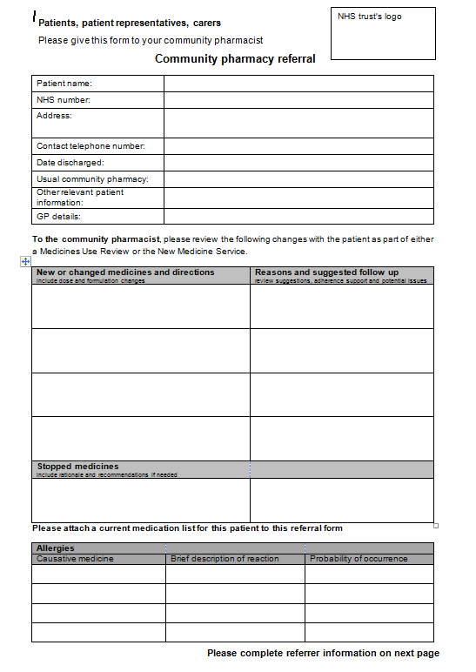
Template Referral Form
For hospitals to use for referring patients to their community pharmacy
Can be given to the patient to take to the pharmacy or with patient’s consent, can be sent to the community pharmacy via e.g. secure email / fax
RPS recommended core content of records for transfer of care included on form

Slide 13
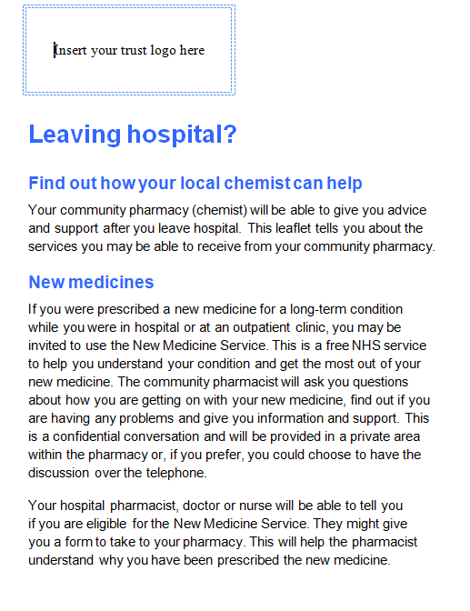
Template Patient Leaflet
Text to use in a template leaflet for patients available
Can be amended to meet local requirements
Describes NMS and MUR to patients

Slide 14
Discussion / Action points
If a hospital decides to refer patients for MUR and NMS:
nominate someone in the pharmacy team to be responsible for implementation of the services and to be the point of contact for community pharmacists
ensure all members of hospital staff who might be referring patients are aware of the NMS disease areas and advise them that they are able to refer to the services

Slide 15
Discussion / Action points
consider how the referral form will be used in your hospital. Ensure that all relevant staff know about it and how to use it
consider how the community pharmacy patient leaflet will be used in your hospital. Amend the wording of the leaflet where relevant and print copies for distribution to patients
determine when and how it will be given to patients

