Slide 1
Alongside the guidance and resources available at psnc.org.uk/flu , PSNC Briefing 042/18 provides detailed information on the flu vaccination Advanced Service and it provides information for speakers using this PowerPoint presentation.
Questions or comments on this presentation can be addressed to Zainab@psnc.org.uk
Last updated: 22nd August 2018

Slide 2
The Community Pharmacy Seasonal Influenza Vaccination Advanced Service 2018/19
Notes:
Alastair begins

Slide 3
Overview
Describe the broad service requirements
Highlight the changes to the service in 2018/19
most have been agreed with NHS England following feedback from contractors and LPCs
Signpost to further documentation and resources which contractors and pharmacists should read
NHSBSA will explain how the new digital payment claim process will work

Slide 4
Background
Commissioned as the 5th Advanced Service in England
Fourth year of the nationally commissioned service
Runs from September to March
Focus of vaccination continues until December

Slide 5
Service documentation
Service specification
Patient Group Direction
Revised guidance on vaccination of patients taking anticoagulants or with a bleeding disorder
Secretary of State Directions (need to have been issued before the service can commence)
PSNC Briefing – Guidance on the Seasonal Influenza Vaccination Advanced Service

Slide 6
Premises requirements​
Pharmacy must have a consultation room which meets existing requirements for provision of MUR/NMS:​
The patient and the pharmacist can sit down together;​
They can talk at normal speaking volumes without being overheard by staff or customers; and​
The area is clearly signed as a private consultation area​

Slide 7
Training requirements
Successfully complete practical training course before self-declaration – list of training providers on PSNC website
Face to face injection technique and basic life support training - every three years (previously was every two years)
Declaration of Competence (DoC) – Vaccination services – every two years
No need to complete new DoC if completed DoC last year
New vaccinators – undertake a period of supervised clinical practice

Slide 8
Practicalities of service provision
Arrangements for disposal of clinical waste
Hepatitis B vaccinations
Standard Operating Procedure
Needle stick injury procedure
Anaphylaxis pack
Service availability over full opening hours
No longer a requirement to complete a form on the NHS BSA website before providing the service

Slide 9
Patient eligibility (aged 18 years and over)
People aged 65 years and over (including those becoming age 65 years by 31st March 2019)
Pregnant women
Carers
Household contacts of immunocompromised individuals
People aged 18-64 in clinical at-risk groups
People living in long-stay residential care homes or other long-stay care facilities

Slide 10
Patient eligibility (aged 18 years and over)
Social care workers
Health and social care staff, employed by a registered residential care/nursing home or registered domiciliary care provider, who are directly involved in the care of vulnerable patients/clients
Hospice workers
Health and care staff, employed by a voluntary managed hospice provider, who are directly involved in the care of vulnerable patients/clients

Slide 11
Patient eligibility
If patients are not eligible for the Advanced Service:
but are eligible for NHS vaccination, refer to their GP practice
and not eligible for NHS vaccination, potentially offer them a private service

Slide 12
Paperwork for the service
Consent form
Record form
GP notification form
Patient questionnaire
Claim form – paper or NHS BSA webform
Use of IT systems (e.g. PharmOutcomes and Sonar)

Slide 13
Types of vaccines in 2018/19
The Joint Committee on Vaccinations and Immunisation advised that two types of vaccines should be used in 2018/19:
Adjuvanted trivalent flu vaccine (aTIV) (Fluad®)
This is licensed for people aged 65 years and over; the deadline to order was April 2018
Quadrivalent vaccine (QIV)
This is recommended for the ‘at-risk’ groups, i.e. adults aged 18-64

Slide 14
Vaccine deliveries
aTIV deliveries to pharmacies and GPs have to be staged across three months:
September (40%), October (20%) and November (40%)
Pharmacies should already have been notified of the week of delivery for each of the three batches of aTIV
The phased delivery will present logistical challenges for the 65s and over age category
QIV delivery dates will have been advised by the supplier

Slide 15
aTIV prioritisation approach
NHS England guidance sets out a three-phased prioritisation approach to vaccinating patients aged 65 years and over:
First priority should be given to those aged 75 years and over or those in a care home
Second priority should be given to those aged 65-74 years in a clinical risk group
Third priority should be given to those aged 65-74 years NOT in a clinical risk group
However, if an eligible patient presents at the pharmacy seeking vaccination and the appropriate vaccine is available, do vaccinate them

Slide 16
Advice on planning for the over 65s campaign
Communicate arrangements to patients from August onwards through all the communications channels you usually use: website, posters, leaflets, messages on prescription bags etc.
Use messages in national NHS England communications:
Vaccination will be offered to everybody before the end of November so make sure you get vaccinated by then
Work with local GPs to help ensure consistent messaging
If no vaccine is immediately available, tell the patient when the next delivery is due

Slide 17
Off-site vaccination
Vaccinating patients in care homes or long-stay residential nursing homes
no longer need to wait for permission/approval from the local NHS England team
contractors still need to notify the patient’s GP practice prior to vaccinating these patients
Contractors can also now administer a flu vaccination at a patient’s home, where:
this service is requested by the patient
and providing the pharmacy has an existing clinical relationship with the patient
Notification of intent to provide off-site NHS flu vaccinations form

Slide 18
Fees and payment
Increased fee agreed (+34p): £7.98 + £1.50 (£9.48) per administered dose
Reimbursement of vaccine costs at basic price (list price) of the individual vaccine administered + an allowance at the applicable VAT rate
Claim payment via the electronic NHS BSA webform or paper claim form sent to the NHS BSA at month end
Claims will be accepted by the NHS BSA within six months of administration of the vaccination, in accordance with the usual Drug Tariff claims process

Slide 19
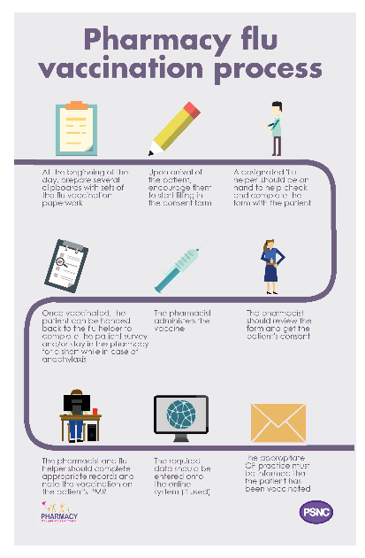
Implementation
Get all the team involved in the process​
Appointments or drop in?​
Promotion​
Paperwork​
Stock levels
Signposting if appropriate vaccine is unavailable
Notes:
Ben’s section coming up

Slide 20
NHSBSA digital submission process Flu Vaccination claims 2018/19
Notes:
Ben starts

Slide 21
Who we are
NHS Prescription Services is part of the NHS Business Services Authority (NHSBSA)
We price NHS prescriptions and make monthly payments to community pharmacy contractors for the NHS services they provide
Currently, payments are made based on submissions made to us on FP34C submission forms

Slide 22
Video demonstration
Please note:
Screens of the application shown in this video are of a prototype and for demonstration purposes only
Details of the flu vaccines which can be administered are to be added to the application
The declaration wording is subject to change

Slide 23
Digital flu submission video
Access video using YouTube link below
https://youtu.be/NWMj41efZHI
Notes:
Digital submission video

Slide 24
Benefits of using the digital flu submission
Submit your flu submission to the NHSBSA faster
Reduce the amount of forms you need to print for your monthly submission batch
Receive a real-time confirmation that your submission has been received, reducing the concern of it being lost in transit
Receive an email confirmation providing a summary of your submission
Pharmacy details
Totals submitted for each vaccine
The name of who completed the submission
Time and date of when the submission was sent
If you’re part of a pharmacy group, you can get a copy of your confirmation email sent to your head office

Slide 25
General information
Use of the digital flu submission is optional
Check with your pharmacy owners/head offices that they agree to using the application.
If you’d prefer to submit a paper claim, continue to do so
Do not complete a digital flu submission and a paper claim for the same submission period
Duplicate claims will be identified by the NHSBSA and clarified with the pharmacy. This could result in payment delays
There are no changes to the back-end process completed by the NHSBSA

Slide 26
The digital flu submission process
On 25th September 2018, you will receive a unique URL to your shared premises NHS Mail address
On 1st of October 2018, a further unique URL will be sent URL to your shared premises NHS Mail address, for the same submission period
Each unique URL for your pharmacy is generated monthly and time stamped
You can only claim for the month valid to the timestamp
It will not allow you to claim for a future month
There is no change to the payment timeline for digital submissions
Submissions should still be sent no later than the fifth day of the month
Further information and guidance will be available on the NHSBSA website prior to the service going live
Notes:
Ben’s final slide

Slide 27
Summary of changes to the 2018/19 service
Training requirements - training interval increased to every three years
Sign-up with NHS BSA – requirement to register before the service has been removed
Eligibility criteria – addition of social care workers and hospice workers to the ‘at-risk’ groups
Paperwork – consent form, record form, patient questionnaire and GP notification form all updated
Notes:
Back to Alastair

Slide 28
Summary of changes to the 2018/19 service
Type of vaccine – new recommendations this season and prioritisation approach for aTIV
Off-site vaccinations
vaccination of patients in their own homes permitted
permission not required to vaccinate care home residents but notification to NHS England required before any off-site vaccination
Claiming for payment – digital or paper option to claim every month
Funding – increase in remuneration for the service

Slide 29
Further information and resources
psnc.org.uk/flu
FAQs available at psnc.org.uk/flufaqs
Sign up to PSNC enews at psnc.org.uk/enews
@PSNCNews
Good luck with the service in 2018/19!

Slide 30
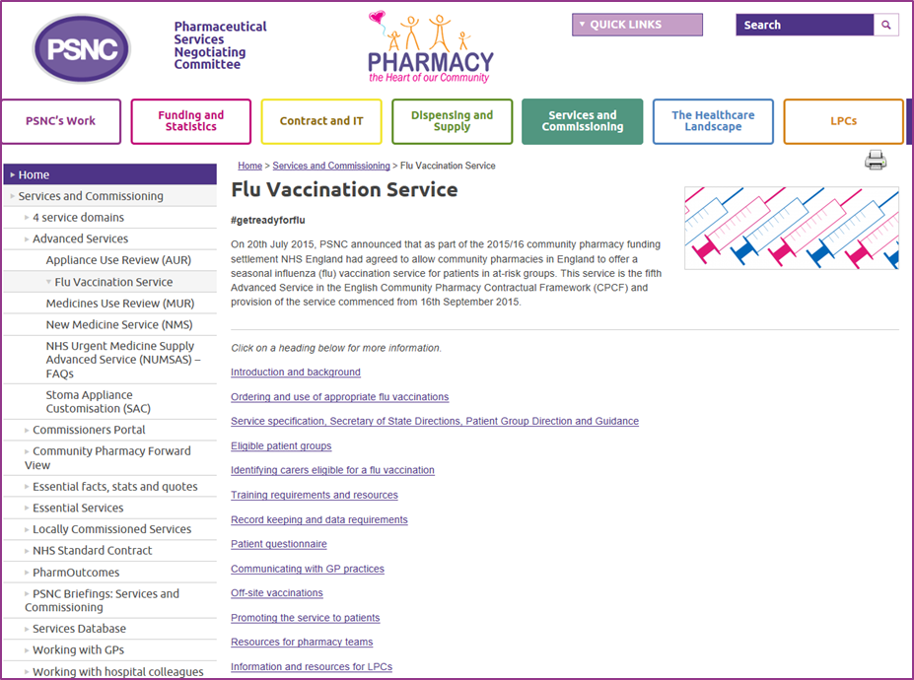
Questions
psnc.org.uk/flu
If you would like any more information on the digital submission process, please contact nhsbsa.mys@nhs.net
Notes:
Alastair leads Q&A

