Slide 1
The Community Pharmacy Hypertension Case-Finding Advanced Service
Anne Joshua
Head of Pharmacy Integration
Primary Care, Community Services and Strategy Directorate
NHS England and NHS Improvement
David Onuoha
Service Development Manager
Pharmaceutical Services Negotiating Committee
Jackie Buxton
Pharmacy Integration Lead – Midlands & Hypertension Pilot Project Lead
NHS England and NHS Improvement

Slide 2
Overview
Policy context & background (Anne Joshua)
Service requirements & operational context (David Onuoha)
Learnings from the pilots: Top tips & considerations (Jackie Buxton)
Questions

Slide 3
NHS Community Pharmacy Hypertension Case-Finding Advanced Service Policy context and background
7th October 2021
Anne Joshua, Head of Pharmacy Integration
Pharmacy Integration Programme, Primary Care Group.

Slide 4
High Blood Pressure and Cardiovascular Disease
Cardiovascular disease (CVD) is one of the leading causes of premature death in England and accounts for 1.6 million disability adjusted life years.
Hypertension is the biggest risk factor for CVD and is one of the top five risk factors for all premature death and disability in England. An estimated 5.5 million people have undiagnosed hypertension across the country.
Early detection of hypertension is vital and there is evidence that community pharmacy has a key role in detection and subsequent treatment of hypertension and CVD, improving outcomes and reducing the burden on GPs,.
According to modelling data from Public Health England, more than 30% of hypertension cases remain undiagnosed, and prevalence is rising across all age groups. Levels of detection are expected to have fallen over the past year due to the impact of COVID-19 on routine blood pressure (BP) monitoring.

Slide 5
Policy Context
Chapter Three of the NHS Long Term Plan (LTP) commits the NHS to reducing mortality and morbidity due to CVD, tackling inequalities and shifting towards prevention strategies. The LTP specifically states that community pharmacy, in collaboration with other providers, will provide opportunities for the public to check on their health through tests for high blood pressure and other high-risk conditions.
NICE guideline NG136 sets out the criteria that should be used for the diagnosis and management of hypertension in adults. It specifies that ambulatory blood pressure monitoring (ABPM) is the clinically preferred method for diagnosing hypertension. Home blood pressure monitoring is only an acceptable alternative where the patient cannot tolerate ABPM and may be used for ongoing monitoring for those patients who have a prior diagnosis of hypertension.
https://www.longtermplan.nhs.uk/wp-content/uploads/2019/08/nhs-long-term-plan-version-1.2.pdf
https://www.nice.org.uk/guidance/ng136
As part of the 2019-2024 Community Pharmacy Contractual Framework, it was agreed that a model for detecting undiagnosed CVD in community pharmacy would be piloted in 2020/21 through NHS England and NHS Improvement’s (NHSE&I) Pharmacy Integration Fund.
The hypertension case-finding pilot commenced in December 2020 across several Primary Care Networks (PCN). These pilots have informed the service specification for this advanced service.

Slide 6
Pilot sites
Pilot sites were selected using criteria including: prevalence of undiagnosed hypertension/CVD risk factors; areas that encompass rurality, deprivation, mixed urban/rural; local intelligence; and impact of Covid-19
35 pharmacies participated in the pilot from 6 PCNs in 4 geographies:
Darlington & Durham PCN in North East England
Urban Health and Dudley & Netherton PCNs in the West Midlands
Chesterfield & Dronfield PCN in the East Midlands
Newham Central and North Newham PCNs in London
These pilot sites include rural and urban areas, areas of high ethnicity and areas of mixed deprivation/affluence
The pilots were ready to start in December 2020 but the national lockdown resulted in delays. The majority of pharmacies started after 29th March when restrictions eased and the pilot ended 30th September 2021.
Evaluation is due to complete reporting late Autumn 2021

Slide 7
Impact of Covid-19
Changes to the service model
We consulted with stakeholders and surveyed pharmacies and GPs in pilot areas to determine whether the model of care needed to be revised in light of the Covid-19 pandemic
Additional means of finding potential service users to be considered as pharmacies are expected to welcome fewer casual customers, e.g. community settings and places outside the pharmacy consultation room, and target undiagnosed patients from GP lists, working with PCNs in the pilot sites.
If local practices request pharmacies in the pilot to carry out clinic BP measurement for diagnosed patients then this will be supported in recognition of working as part of the PCN to carry out BP monitoring when Covid-19 may have impacted on access to BP measurement.
Changes to the evaluation plan
Undertake case study/qualitative analysis for each pilot site over a minimum of 3 months with a focus on informing wider implementation. ‘Early learning’ report in Jan 2021, full report in Autumn 2021
A further aim of the evaluation will be to identify the minimum dataset to be sent to GPs from pharmacies to inform the digital data standards required that will be developed over the next 12 months as part of a separate digital workstream across all PhIF pilots.
Ongoing service monitoring will be established to support service development to inform what would be required as part of an agreed service delivered through the CPCF that aligns with the PCN CVD DES.

Slide 8
Public Perceptions: Ipsos survey and interviews
Although most people would be comfortable with this service, a number of groups are more likely to say they would not be comfortable. This includes:
Older people: 12% of people aged 65+ say they would not feel comfortable, compared with eight per cent overall.
People who are not working: 11% say they would not be comfortable with this service, compared with five per cent of those who are working.
People with no formal qualifications: 11% say they would not be comfortable with this service compared with five per cent of people with A Level or equivalent qualification.
This may be linked with age as this group includes people who are retired and likely to be aged 65+

Slide 9
Service requirements & operational context
David Onuoha
Service Development Manager
Pharmaceutical Services Negotiating Committee

Slide 10
Overview
Service description and documentation
BP meters to be used in the service
Pre-commencement activity
Patient eligibility
Providing the service
Funding and claiming payment

Slide 11
Service Description
The service is an Advanced service
It commenced on 1st October 2021
Two stages:
Stage 1 - identify people at risk of hypertension – ‘Clinic check’
Stage 2 - 24-hour ambulatory blood pressure monitoring (ABPM)
Contractors must be able to provide both stages
Currently only provided by pharmacists

Slide 12
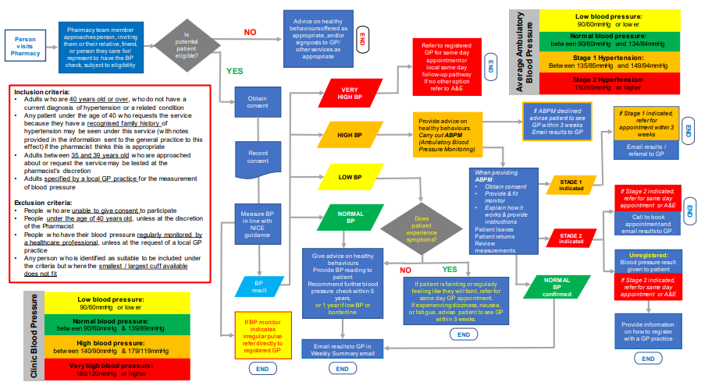
Service description – service pathway

Slide 13
Service documentation
Service specification
Secretary of State Directions
Service pathway
PSNC Briefing 041/21: Guidance on the Community Pharmacy Hypertension Case-Finding Advanced Service
Links to all of the above can be found at: psnc.org.uk/hypertension

Slide 14
BP meters to be used in the service
Purchase or rent equipment
A meter for each service stage – clinic BP & ABPM
Must be validated by the British and Irish Hypertension Society (BIHS)
Considerations before purchasing / renting at: psnc.org.uk/hypertension
Don’t forget your ancillaries (larger cuff sizes etc.)

Slide 15
Pre-commencement activity
Premises requirements​
Pharmacy must have a consultation room which meets the Terms of Service requirements
Additional requirements:
when measuring blood pressure, the patient must be able to rest their arm on a table / bench at a suitable height
IT equipment accessible within the room

Slide 16
Pre-commencement activity
Training requirements
Currently the service is to be provided by a pharmacist
Familiar with the NICE guideline Hypertension in adults: diagnosis and management [NG136]
Read and understood the service specification
Completed the recommended training on how to use the blood pressure monitoring equipment

Slide 17
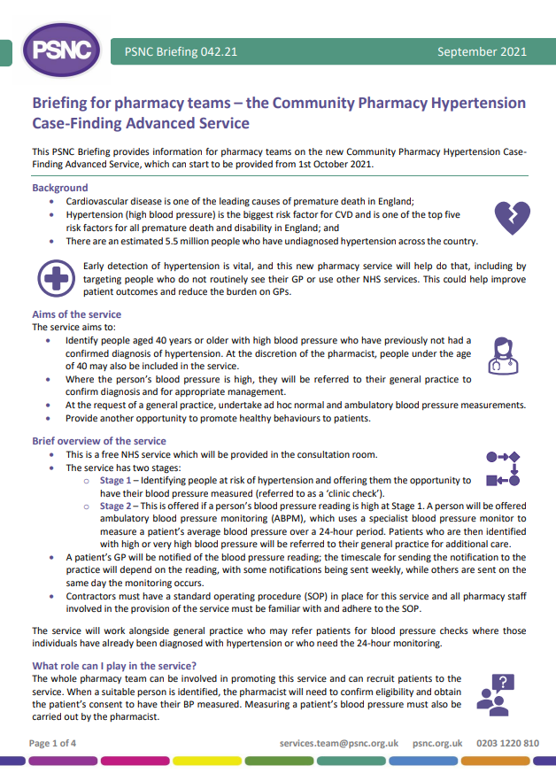
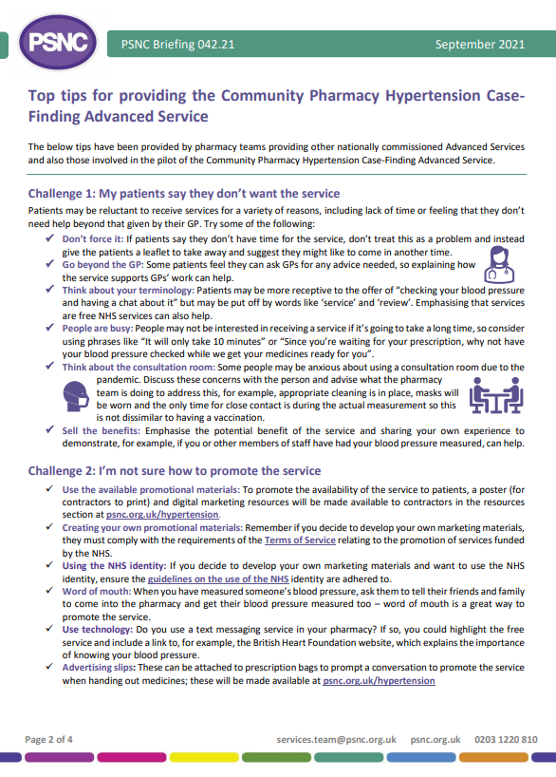
Pre-commencement activity
Training requirements
Additional optional CPD available via CPPE
Pharmacy Team Training
Whole pharmacy team approach to promotion and recruitment
PSNC Briefing 042/21: Briefing for pharmacy teams – the Community Pharmacy Hypertension Case-Finding Advanced Service
More info at: psnc.org.uk/hypertension

Slide 18
Pre-commencement activity
Signing up to the service
Registration via MYS
Set up fee paid
Standard Operating Procedure
Must have in place
All participating staff familiar and follow
Must include process for maintenance and validation of equipment

Slide 19
Pre-commencement activity
Engage with local GP Practice / PCN
GP practice briefing (coming soon)
Contractor implementation checklist
Step by step guide to prepare
More info at: psnc.org.uk/hypertension

Slide 20
Patient eligibility
Inclusion criteria
Adults ≥ 40 years with no diagnosis of hypertension
By exception, < 40 years with family history of hypertension (pharmacist’s discretion)
Approached or self requested 35-39 years old (pharmacist’s discretion)
Adults specified by a general practice (clinic and ambulatory blood pressure checks).
Exclusion criteria
Unable to give consent
Under 40 years old
People who have their blood pressure regularly monitored by a healthcare professional
Additional consideration
Unable to support due to cuff size

Slide 21
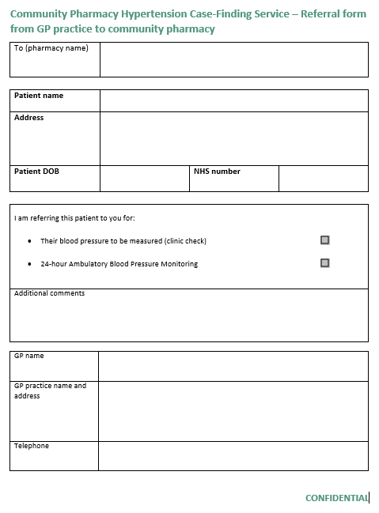
Patient eligibility
GP referrals
Can refer patients for both normal BP checks and ABPM
Need a locally agreed process
No specific requirements for the process
ABPM referrals best done electronically
Template referral form at: psnc.org.uk/hypertension

Slide 22
Providing the service
Promoting the service
Off-site provision (by NHSE&I agreement only)
Patient advice
Consent is verbal

Slide 23
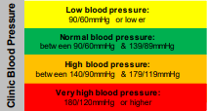
Providing the service – Clinic check
Take a BP reading in both arms
Measure BP in line with NICE guidance
Both readings <140/90mmHg
Both readings ≥140/90mmHg
One reading <140/90mmHg and the other reading ≥140/90mmHg
Follow the service pathway
Take a third reading on the arm with the highest BP
If NOT substantially different from the first reading from that arm, use the lower of the two readings
If substantially different from the first reading from that arm
Take another reading in that arm and use the lower of the last two readings

Slide 24
Providing the service – Clinic check
Low blood pressure:
90/60mmHg or lower
Normal blood pressure:
between 90/60mmHg & 139/89mmHg
Does patient experience symptoms?
If BP monitor indicates irregular pulse refer directly to registered GP
Give advice on healthy behaviours
Provide BP reading to patient
Recommend further blood pressure check within 5 years,
or 1 year if low BP or borderline
YES
NO
If patient is fainting or regularly feeling like they will faint, refer for same day GP appointment.
If experiencing dizziness, nausea, or fatigue, advise patient to see GP within 3 weeks.
Email results to GP in Weekly Summary email
END
END

Slide 25
Providing the service - ABPM
Provision
Loan arrangements - template loan agreement at: psnc.org.uk/hypertension
Reset the ABPM
Fit the ABPM to the patient
Explain the functioning
Confirm understanding
Explain not to get the ABPM wet
Arrange a follow up appointment
Failure to attend
Two attempts to contact (on separate occasions)
Notify GP practice and provide clinic BP reading

Slide 26
Providing the service - ABPM
Return and follow up
Retrieve consultation data
Record the average daytime, night-time and 24-hour blood pressure readings
Based on the average 24-hour reading, follow service pathway
GP practice notification to include all six readings (systolic and diastolic for day, night and 24-hour average) and the full ABPM report
Failure to attend
Make attempts to contact
If no contact or return after 5 days:
Notify GP practice and provide clinic BP reading
Suspend service until the ABPM meter is retrieved or replaced

Slide 27
Providing the service - ABPM
Outcomes
Normal blood pressure:
between 90/60mmHg and 134/84mmHg
Stage 1 Hypertension:
Between 135/85mmHg and 149/94mmHg
Stage 2 Hypertension:
150/95mmHg or higher
Give advice on healthy behaviours
Provide BP reading to patient
Recommend further blood pressure check within 5 years
or 1 year if low BP or borderline
If Stage 2 indicated, refer for same day appointment or A&E
If Stage 1 indicated, refer for appointment within 3 weeks
Call to book appointment and
email results to GP.
Unregistered:
Blood pressure result given to patient
Email results / referral to GP
Email results to GP in Weekly Summary email
END
Provide information on how to register with a GP practice
END
END
END

Slide 28
Providing the service
Blood pressure readings
Discuss & provide
leaflet to support at: psnc.org.uk/hypertension (coming soon)
Healthy lifestyle advice
MECC mindset
Discuss lifestyle/behaviours
Consider local services that could support

Slide 29
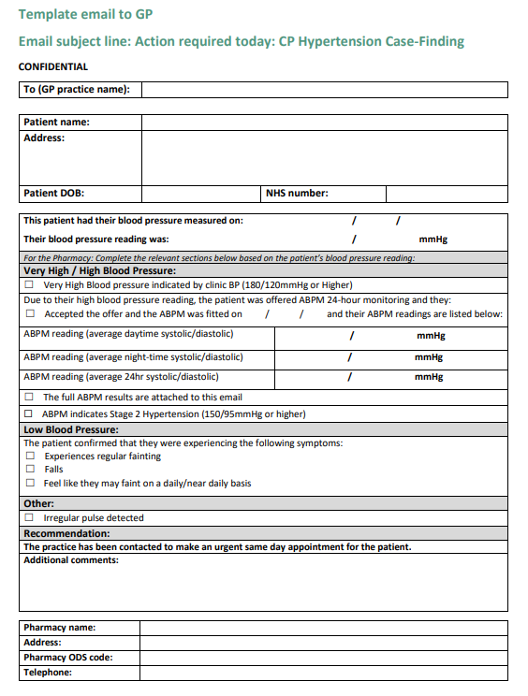
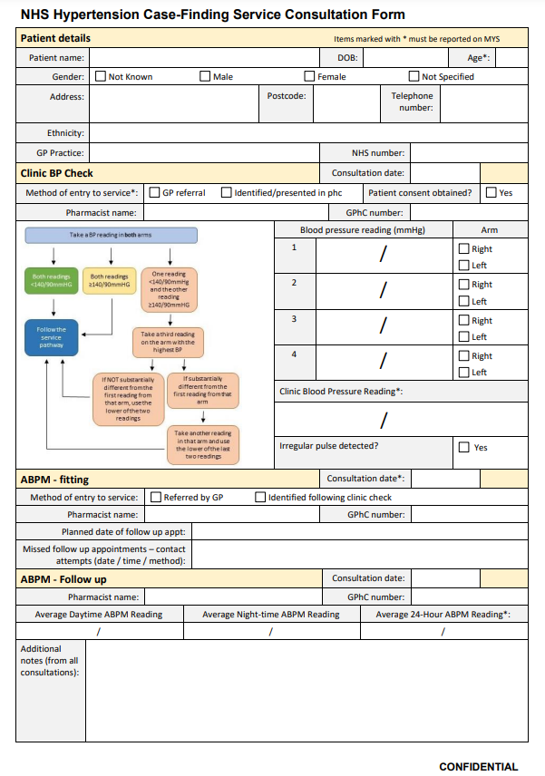
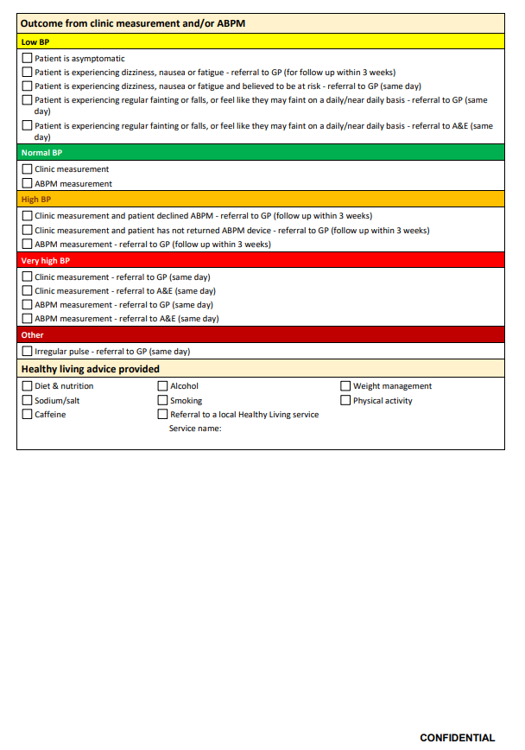
Providing the service
Communicating with GP practices
Service specification Appendix B
Weekly summary & referral templates to support at: psnc.org.uk/hypertension
Record keeping and data management
Currently no IT systems to support
Template clinical record form at: psnc.org.uk/hypertension
Application programming interface (API) will be developed to simplify data management and claim submission in IT systems
Period of retention of clinical records determined by contractor

Slide 30
Funding and claiming payment
Set-up fee of £440;
Fee for each clinic check of £15
Fee for each ambulatory monitoring of £45.
Incentive fees for Years 3, 4 and 5 of the CPCF 5-year for achieving ABPM targets:
£1,000 will be available if 5 ABPM intervention are provided in 2021/22;
£400 for 15 ABPM interventions in 2022/23 and
£400 for 20 ABPM interventions in 2023/24.
Incentive payments from outside the global sum
Incentive supports capital costs of equipment purchase
GP practice referrals paid at the same rates

Slide 31
Funding and claiming payment
Dataset to report to MYS for claims in Appendix C of service specification
Age of patient
Date of service provision
Clinic reading (systolic and diastolic)
If clinic reading, was this opportunistic or referred from a GP?
ABPM reading (average 24hr systolic and diastolic)
If ABPM, was this opportunistic or referred from a GP?
Report completed service provision only
Claim payment via the NHSBSA Manage Your Service (MYS) application – psnc.org.uk/mys
Claim month by the 5th of the month following completion. Later claims will not be processed

Slide 32
NHS Community Pharmacy Hypertension Case-Finding Advanced Service Learnings from the pilot sites: Top tips and considerations
7th October 2021
Jackie Buxton, Regional Pharmacy Integration, Midlands Region and Hypertension pilot project lead
Pharmacy Integration Programme, Primary Care Group.

Slide 33
Thank you to our pilot pharmacy sites
The information here is based on their insights and feedback
In preparation for the service
During service provision
When the service becomes ‘Business as usual’

Slide 34
PCN Network Contract Direct Enhanced Service – CVD Prevention
NHS England » Network Contract Directed Enhanced Service – cardiovascular disease prevention and diagnosis: supplementary guidance
Service requirement: ‘Working pro-actively with community pharmacies to improve access to blood pressure checks, in line with the NHS community pharmacy hypertension case finding service’
Alignment with the NHS community pharmacy hypertension case finding service will support delivery. This service will enable both opportunistic blood pressure testing and where clinically indicated, clinic BP checks or ABPM, on behalf of a PCN, referring the patient back for confirmation of the diagnosis and treatment as required. Pharmacies will be able to choose to register to deliver the service from October 2021.

Slide 35
Contact and engage your local practices
Let them know when you are going to start providing the service
Explain that you will be sending all results to them
Link in that this will help them with the CVD DES
Ask if they would like you to complete any BP measurements for them and agree how they will let you know which patients
LPCs can help by engaging with the system CVD teams, the PCN Clinical Directors and PCN Clinical Pharmacist teams

Slide 36
Engaging patients
Reminder of the inclusion criteria:
Adults who are 40 years old or over, who do not have a current diagnosis of hypertension;
Patients, by exception, under the age of 40 who request the service because they have a recognised family history of hypertension may be provided the service at the pharmacist’s discretion;
Patients between 35 and 39 years old who are approached about or request the service may be tested at the pharmacist’s discretion; and
Adults specified by a general practice for the measurement of blood pressure (clinic and ambulatory blood pressure checks). This process should be agreed locally with general practices.

Slide 37
Engaging patients
Use your pharmacy team to help:
Make sure they understand the importance of the service
What words are they using?
Be realistic about the time taken
Do they find a leaflet or poster helpful?
Expect some people to say ‘no’ and don’t be put off asking others

Slide 38
Other tips before you start
Wear the ABPM yourself so you know what it feels like and can explain this to patients
Have you got some eligible pharmacy team members who can be your first patients for this service to build your confidence?
Use the implementation checklist (PSNC website – resources)
Agree your COVID processes

Slide 39
During the service
One of our pilot pharmacies found it helpful (with patient consent) to print the front page of the patient’s SCR before starting which provides much of the initial information you are capturing from the patient
Follow NG 136
Have a copy (laminated?) of the pathway so you can refer to it
When patients need ABPM consider the best time to fit it. Pilot pharmacies found asking the patient to come for fitting one day at 9:00 and then return the next day at 9:00 for removal and for them to interpret the results worked for them
When ABPM is required there is a loan agreement form on PSNC resources

Slide 40
Advice on healthy behaviours offered as appropriate, and/or signposts to GP/ other services as appropriate
Average Ambulatory Blood Pressure
Low blood pressure:
90/60mmHg or lower
Pharmacy team member approaches person, inviting them or their relative, friend, or person they care for/ represent to have the BP check, subject to eligibility
Is potential patient eligible?
NO
Person visits Pharmacy
END
Normal blood pressure:
between 90/60mmHg and 134/84mmHg
Refer to registered GP for same day appointment or
local same day follow-up pathway
If no other option refer to A&E
Stage 1 Hypertension:
Between 135/85mmHg and 149/94mmHg
YES
END
VERY HIGH BP
Stage 2 Hypertension:
150/95mmHg or higher
Inclusion criteria:
Adults who are 40 years old or over, who do not have a current diagnosis of hypertension or a related condition
Any patient under the age of 40 who requests the service because they have a recognised family history of hypertension may be seen under this service (with notes provided in the information sent to the general practice to this effect) if the pharmacist thinks this is appropriate
Adults between 35 and 39 years old who are approached about or request the service may be tested at the pharmacist’s discretion
Adults specified by a local GP practice for the measurement of blood pressure
Exclusion criteria:
People who are unable to give consent to participate
People under the age of 40 years old, unless at the discretion of the Pharmacist
People who have their blood pressure regularly monitored by a healthcare professional, unless at the request of a local GP practice
Any person who is identified as suitable to be included under the criteria but where the smallest / largest cuff available does not fit
Obtain consent
If ABPM declined advise patient to see GP within 3 weeks
Email results to GP
If Stage 1 indicated, refer for appointment within 3 weeks
Provide advice on healthy behaviours.
Carry out ABPM (Ambulatory Blood Pressure Monitoring)
HIGH BP
END
Record consent
Email results / referral to GP
LOW BP
When providing ABPM:
Obtain consent
Provide & fit monitor
Explain how it works & provide instructions
Patient leaves
Patient returns
Review measurements
STAGE 1 indicated
If Stage 2 indicated, refer for same day appointment or A&E
Measure BP in line with NICE guidance
NORMAL BP
Does patient experience symptoms?
END
Call to book appointment and
email results to GP.
STAGE 2 indicated
Give advice on healthy behaviours
Provide BP reading to patient
Recommend further blood pressure check within 5 years,
or 1 year if low BP or borderline
Unregistered:
Blood pressure result given to patient
NO
YES
BP result
If patient is fainting or regularly feeling like they will faint, refer for same day GP appointment.
If experiencing dizziness, nausea, or fatigue, advise patient to see GP within 3 weeks.
NORMAL BP confirmed
If Stage 2 indicated, refer for same day appointment or A&E
Clinic Blood Pressure
Low blood pressure:
90/60mmHg or lower
Normal blood pressure:
between 90/60mmHg & 139/89mmHg
If BP monitor indicates irregular pulse refer directly to registered GP
Provide information on how to register with a GP practice
END
High blood pressure:
between 140/90mmHg & 179/119mmHg
Email results to GP in Weekly Summary email
Very high blood pressure:
180/120mmHg or higher
END
END
END

Slide 41
During the service
Be efficient with record keeping:
Consultation form – hard copy or electronically. This is your clinical record so must be kept. A template is available on the PSNC website
Sending results to GPs
MYS - Claim when you have finished the service provision with the patient. Enter on MYS on 1st month for the previous month
Age of patient; Date of service provision; Clinic reading (systolic and diastolic); If clinic reading, was this opportunistic or referred from a GP?; ABPM reading (average 24hr systolic and diastolic); If ABPM, was this opportunistic or referred from a GP?

Slide 42
Business as usual
Celebrate success
Review with your local practices
Consider how to reach more patients

Slide 43
Questions?
psnc.org.uk/hypertension
services.team@psnc.org.uk

Slide 44
Further information and resources
psnc.org.uk/hypertension
FAQs will be available at psnc.org.uk/hypertension
Additional support services.team@psnc.org.uk
Sign up to PSNC enews at psnc.org.uk/enews
@PSNCNews
Good luck with the service!

